Slide 1
November is “Child Safety & Protection Month.” Think about the different items in your house or classroom that may be dangerous for you or other kids. Choose several of the items and explain how they could be made safer by you or an adult.

Slide 2
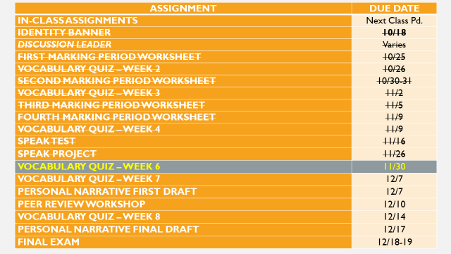

Slide 3
Continue Annotating “A Rose for Emily” by William Faulkner
You will annotate the text as we read.
I will also annotate as we read.
We will be reading this story slowly together so we understand it completely.

